Slide 1

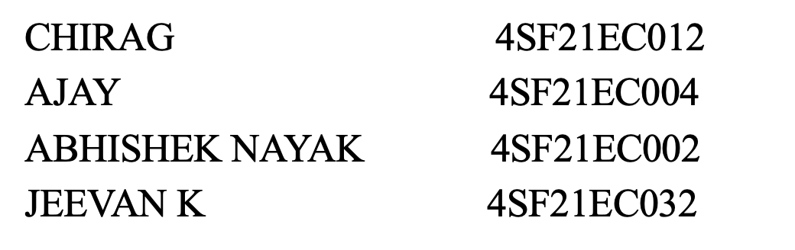
Department of Electronics & Communication Engineering
Project Proposal Presentation on
“GPS-Integrated Autonomous Surface Vehicle for Depth Mapping and Environmental Water Testing”
By
Under the Guidance of
Mr. Praveen Kumar M
Assistant Professor,
Department of Electronic and communication Engineering
2024-25
Notes:
ASDSJDBSD

Slide 2
Introduction
Water survey teams face challenges such as labor-intensive methods, difficult access to remote areas, and inconsistent data quality. Traditional methods often miss trends and can disturb ecosystems. Limited resources and the need for advanced technology expertise add to the difficulties. Autonomous systems can significantly improve efficiency and accuracy in water resource management

Slide 3
Problem Statement
Accurate and detailed information about water bodies is crucial for various applications, including environmental monitoring, hydrographic surveys, aquaculture management, and recreational activities. Traditional methods of gathering water depth and quality data can be labour-intensive, time-consuming, and limited in scope. Autonomous systems offer a promising solution to these challenges by enabling continuous, high-resolution data collection with minimal human intervention.

Slide 4

Current method
Traditional method is used where a team of researchers go to targeted spot and collect water sample for testing.
Uses high end boats for under water survey in oceans but it is not applicable for small water bodies like river , lake etc.
Professional team of divers has been used for bathymetric survey.
Time consuming and investment.

Slide 5
Project Objectives
Autonomous navigation system.
Accurate under water bathymetry, Provide accurate 3d mapping of underwater structures.
The system should be able to sustain the high currents.
Accurate data analysis of water quality,
No manual interference and multipurpose usability.

Slide 6
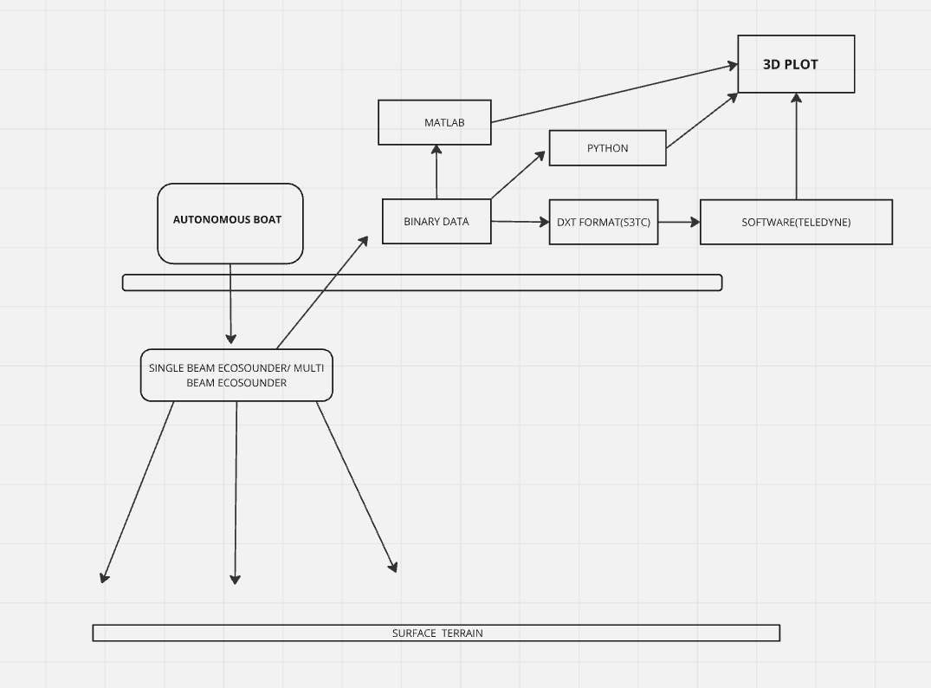
METHODOLOGY

Slide 7
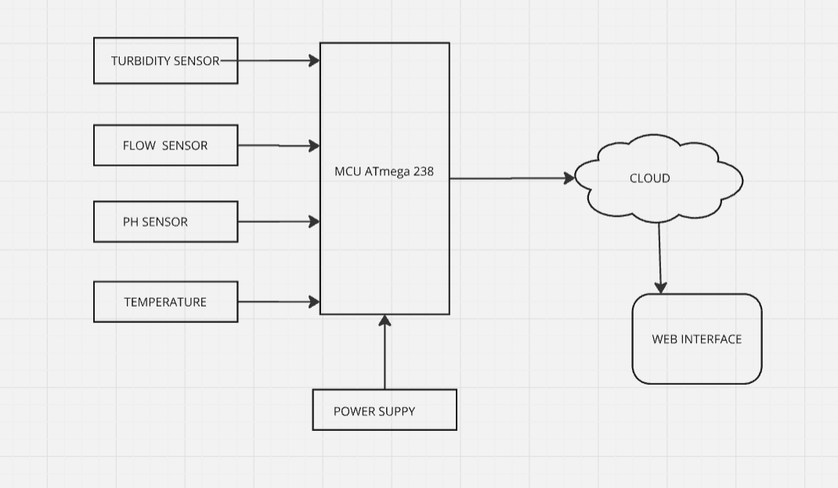
METHODOLOGY

Slide 8
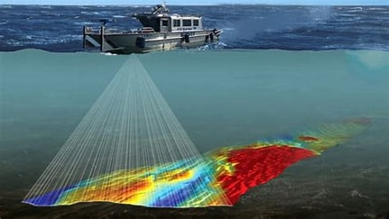
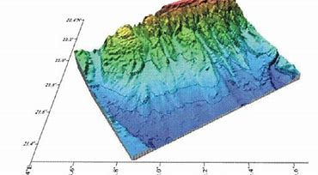
BATHYMATRIC MAPPING PLOT

Slide 9
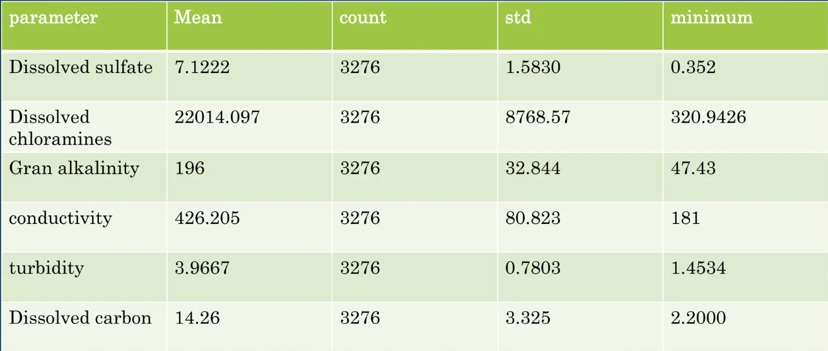
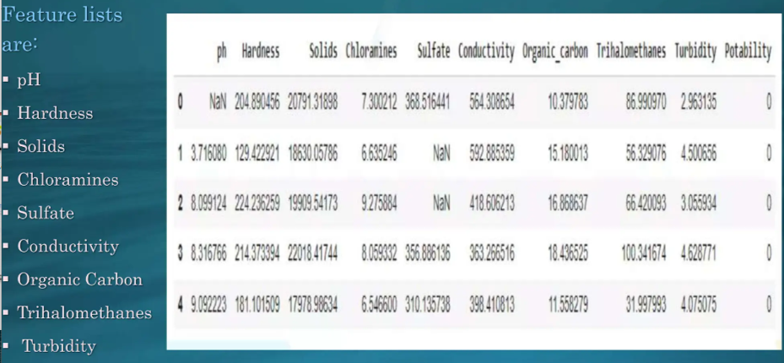
EXPECTED OUTCOMES OF WATER QUALITY

Slide 10
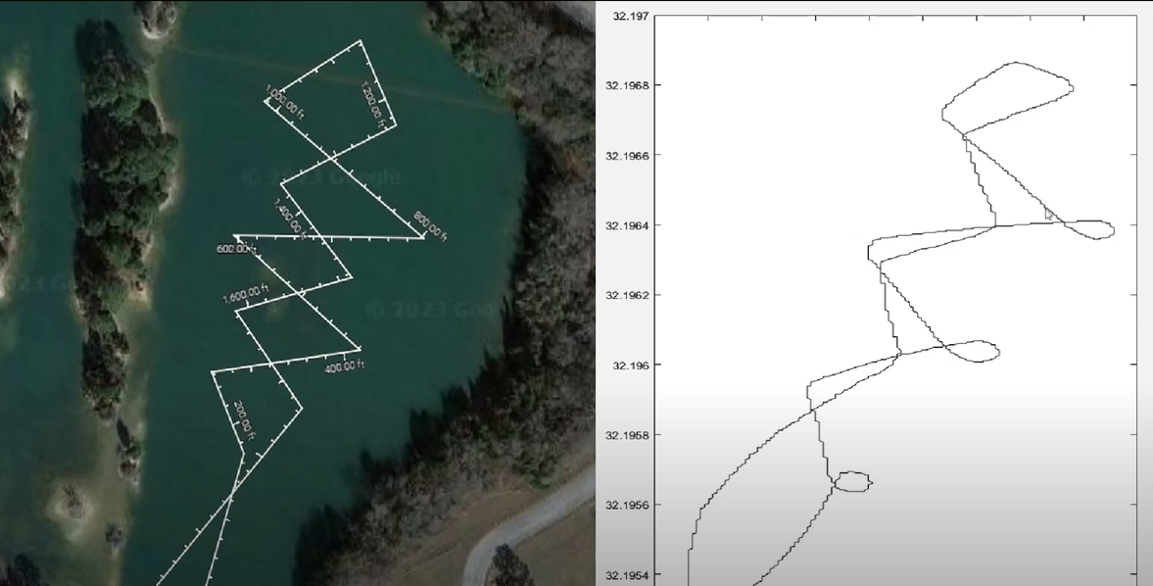
MAPPING

Slide 11
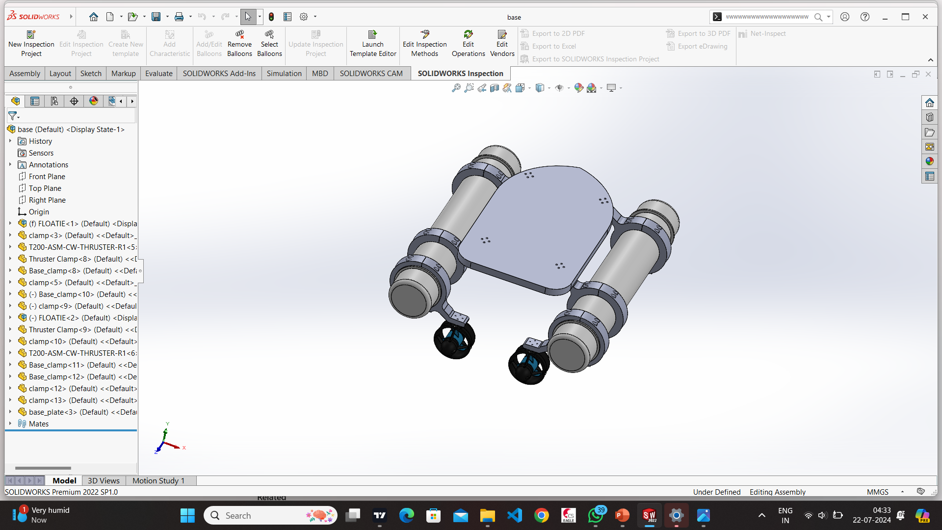
Progress Achieved
Design and calculation

Slide 12
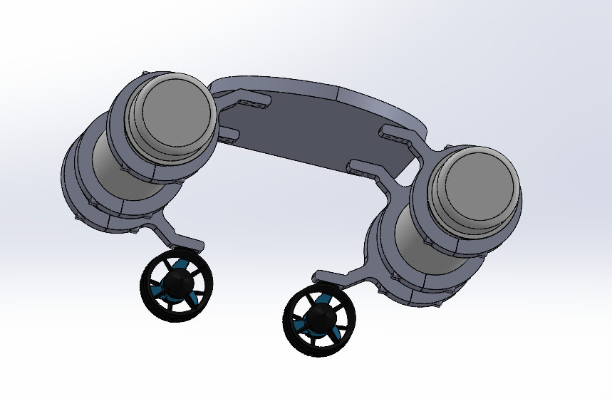
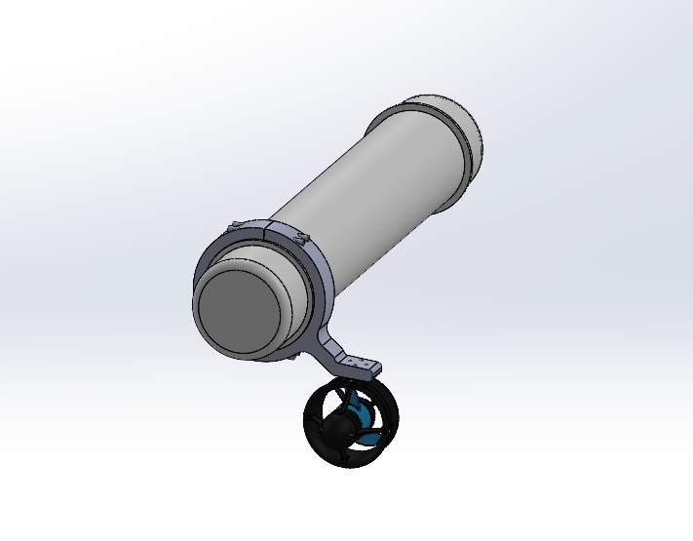
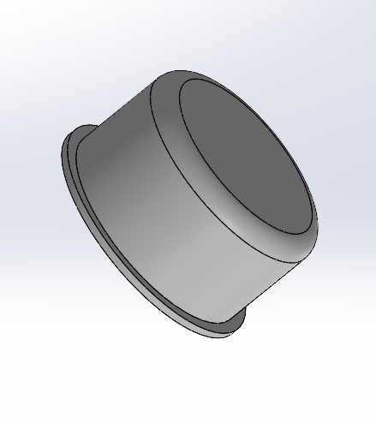
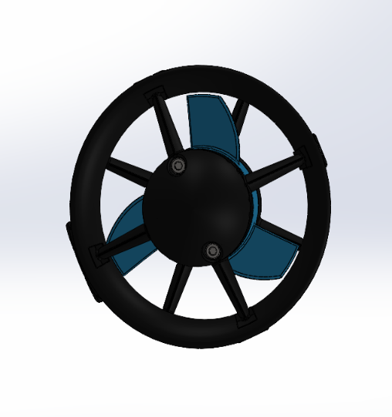
Progress Achieved

Slide 13
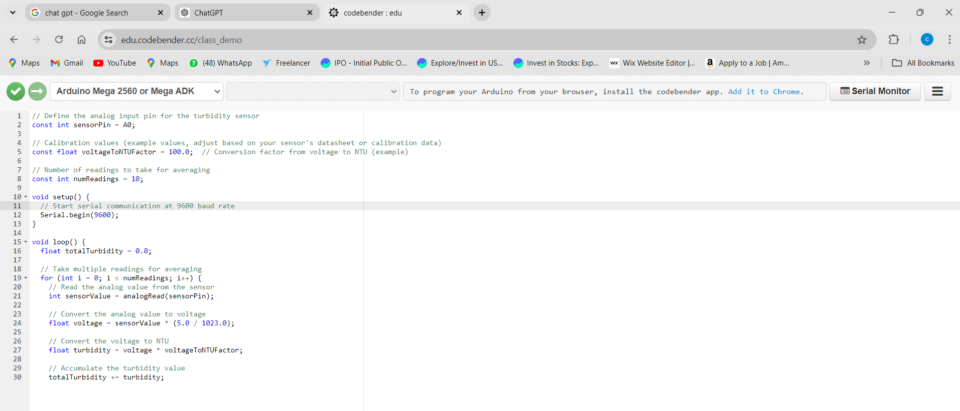
Progress Achieved
Sensor Integration
[turbidity, flow, temperature, PH]

Slide 14
Literature Review
Design of a semi-autonomous boat for measurements of coastal sedimentation and erosion-D. Smith, L. Cross(2021)
Smith and Cross designed a semi-autonomous boat integrating sonar and GPS to measure coastal sedimentation and erosion, emphasizing precise GPS for accurate positioning and sonar for detailed sediment mapping. Their study highlights the challenges of environmental conditions on data accuracy and the need for robust systems in diverse coastal environments. The boat's semi-autonomous nature allows human intervention, enhancing operational flexibility.
Autonomous Real-Time Water Quality Monitoring System(2021)-Salalila, Aljon
Salalila developed a system for real-time water quality monitoring with manual operation, integrating sensors for pH, turbidity, temperature, and dissolved oxygen, with data processed by an onboard microcontroller and transmitted wirelessly. The study highlights effective real-time data collection, sensor calibration, and maintenance for long-term accuracy and reliability in environmental monitoring.

Slide 15
Literature Review
An Unmanned Surface Vehicle (USV): Development of an Manual Boat with a Sensor Integration System for Bathymetric Surveys -Fernando Sotelo-Torres(2023)
Salalila developed a system for real-time water quality monitoring with manual operation, integrating sensors for pH, turbidity, temperature, and dissolved oxygen, with data processed by an onboard microcontroller and transmitted wirelessly. The study highlights effective real-time data collection, sensor calibration, and maintenance for long-term accuracy and reliability in environmental monitoring.
Development of an Autonomous Boat with a Sensor Integration System for Bathymetric Surveys
Sotelo-Torres developed an Unmanned Surface Vehicle (USV) for bathymetric surveys, integrating advanced sensors like multi-beam sonar and GPS for detailed underwater maps. The study highlights advancements in sensor technology, addressing challenges in integration, data processing, and real-time communication, resulting in improved survey efficiency and data accuracy compared to traditional methods.

Slide 16
References
Smith, D. A. N. I. E. L., L. I. N. D. A. Cross, J. A. R. E. D. Rivet, and S. T. E. V. E. N. Hall. "Design of a semi-autonomous boat for measurements of coastal sedimentation and erosion." Proceedings of the International Association of Hydrological Sciences 367 (2015): 447-454.
Salalila, Aljon. Autonomous Real-Time Water Quality Monitoring System. Washington State University, 2021.
Salalila, Aljon. Autonomous Real-Time Water Quality Monitoring System. Washington State University, 2021.
Meuzelaar, Tom, Shannon D. Zahuranec, and James P. Jonas. "Innovative data collection and management strategies for improved water treatment efficiency."
Meuzelaar, Tom, Shannon D. Zahuranec, and James P. Jonas. "Innovative data collection and management strategies for improved water treatment efficiency."
Campbell, M. D., R. Schalla, and D. R. Newcomer. Accuracy and cost effectiveness of manual and automated water-level monitoring technology. No. PNL-7566. Pacific Northwest National Lab.(PNNL), Richland, WA (United States), 1991.
Saleh, Thomas, and Madeline Stanley. "Real-Time Water Quality Monitoring." (2023).

Slide 17
Thank You

